Slide 1
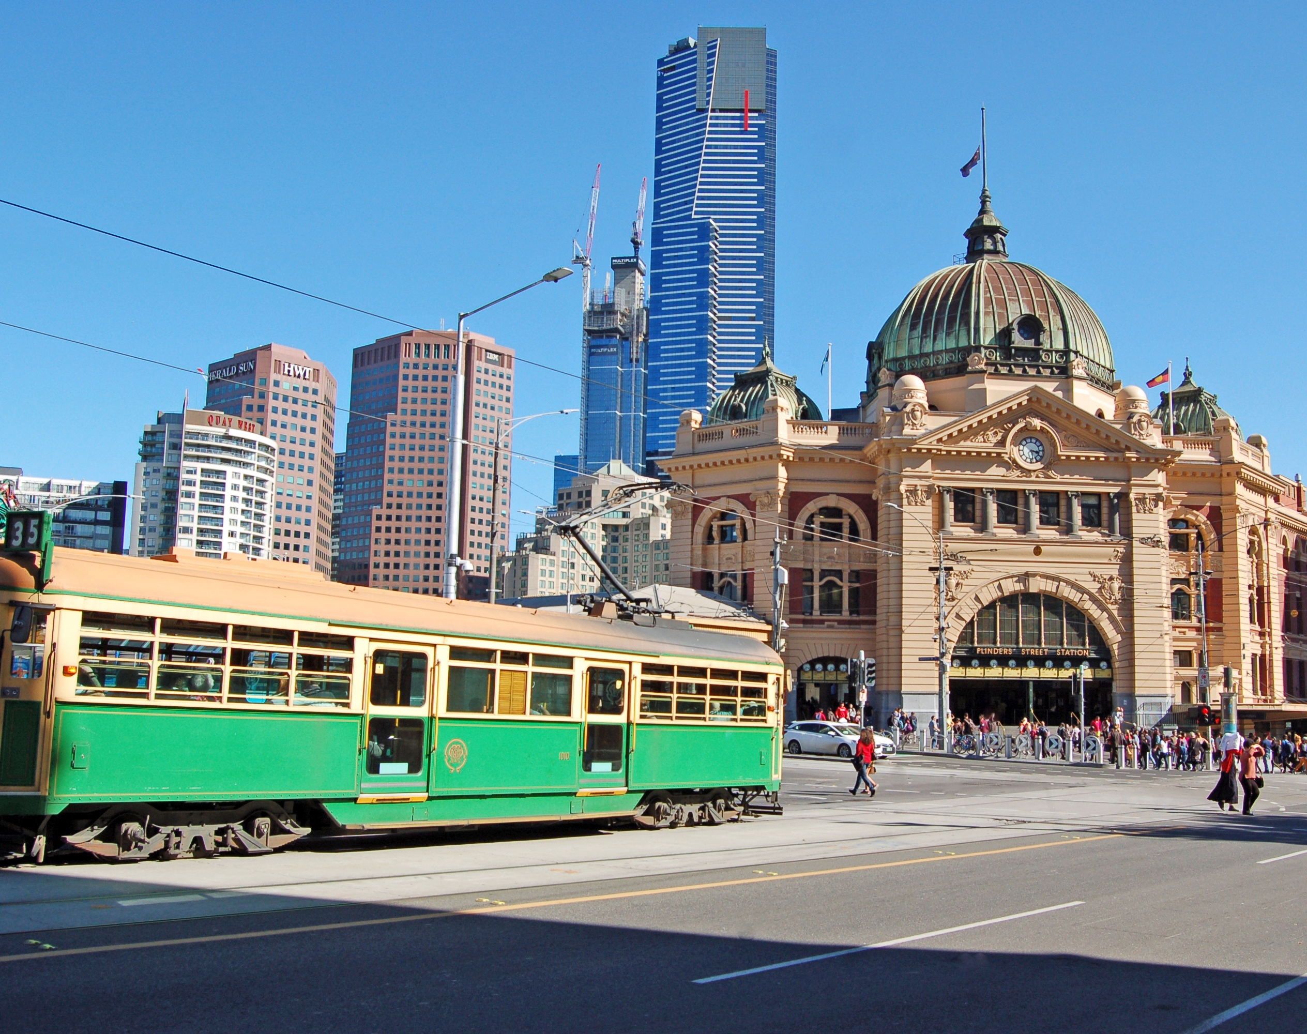
Battle of Neighbourhoods
Clustering suburbs in metropolitan Melbourne
Xiaopeng Gong
28/07/2021

Slide 2
Background
Request:
A start-up company wants to find rental properties for their oncoming overseas employees in metropolitan Melbourne.
Requirements:
15 km in radius distance or equivalently 30mins travel time to the office during peak hours (Office will be in Docklands, VIC 3008)
A safe area with low assaulting class crime incidents
An affordable rental price with a large volume of rental properties available in the market
Easy to access venues such as restaurants, cafe, and parks.

Slide 3
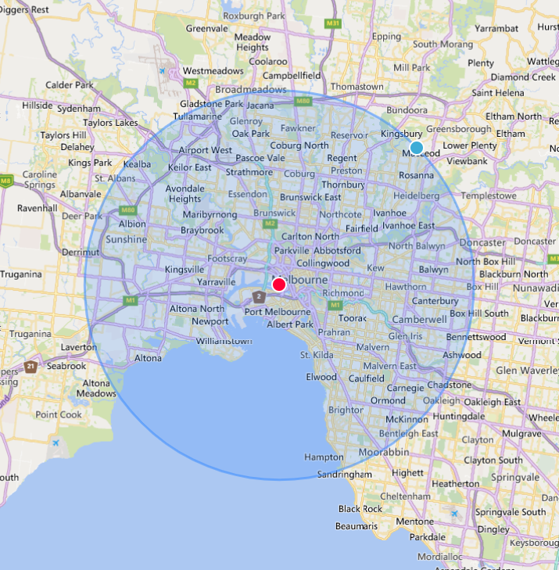
Objectives
Apply clustering to categorize the suburbs in metropolitan Melbourne regarding:
commute time
safety
rental status
venues categories
Accordingly, each cluster was profiled with references to selected attributes to assist in finding the best suitable suburbs

Slide 4
Data acquisition and cleaning
Data requirements
Geographical information by suburb including name, postcode, coordinates, and its corresponding council
Types of crime incidents and their frequencies recorded by suburb
Number of rental properties available and their median prices by suburb
Categories of venues and their numbers by suburb

Slide 5
Data acquisition and cleaning
In this project, all data was collected from free and publicly available datasets
Data sources
General information of suburbs in Metropolitan Melbourne (https://en.wikipedia.org/wiki/List_of_Melbourne_suburbs)
Nominatim API to extract geographical coordinates of each suburb (https://nominatim.org/release-docs/develop/api/Overview/)
Crime Statistics Agency Data Tables - Criminal Incidents (https://discover.data.vic.gov.au/dataset/crime-by-location-data-table)
Rental Report - Quarterly: Moving Annual Rents by Suburb (https://discover.data.vic.gov.au/dataset/rental-report-quarterly-moving-annual-rents-by-suburb)
Foursquare API to extract venues information (https://developer.foursquare.com/docs/places-api/)

Slide 6
Data acquisition and cleaning
Duplicate, highly correlated features were removed
Dataset | Geographical | Crime | Rental | Venue
Data Structure (Raw) | 583 entries, 5 attributes | 317503 entries, 12 attributes | 159 entries, 170 attributes | 3711 entries, 7 attributes
Data Structure (Clean) | 546 entries, 5 attributes | 170541 entries, 12 attributes | 13991 entries, 9 attributes | 3711 entries, 7 attributes
Missing Values Method | Manually | Ignored | Using the mean values calculated from surrounding suburbs | The most frequent value

Slide 7
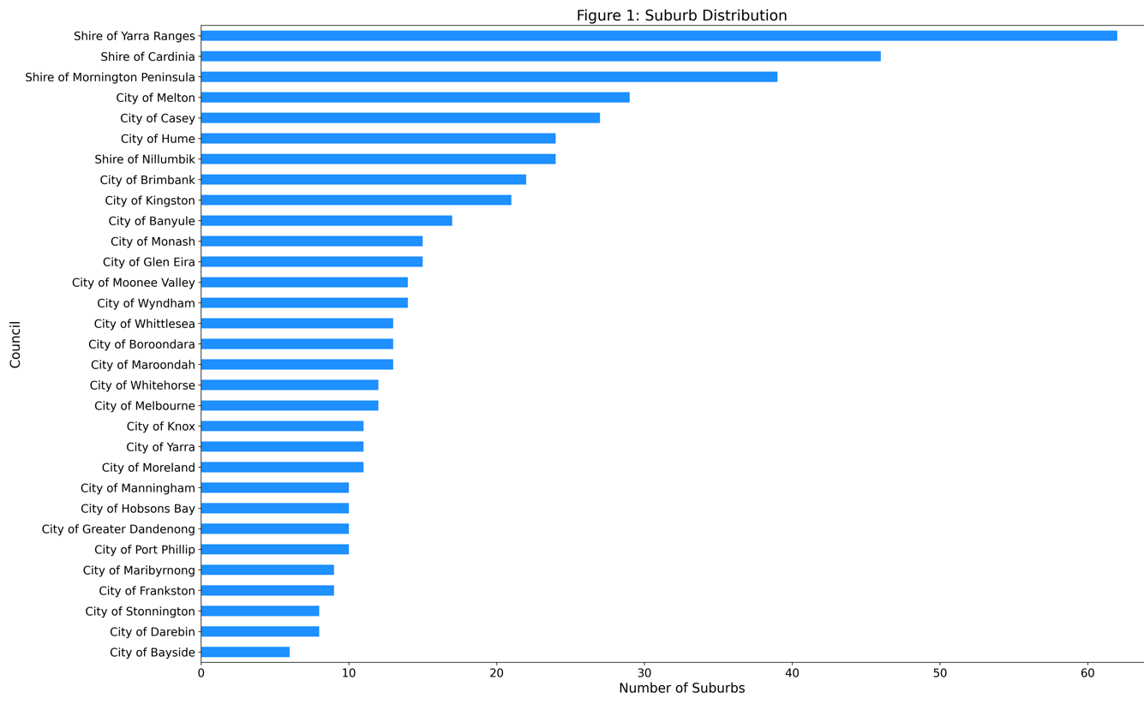
Distribution of suburbs in metropolitan Melbourne
There are 545 suburbs distributed in 31 councils in metropolitan Melbourne
Shire of Yarra Ranges has the most suburbs
City of Bayside has the least suburbs

Slide 8
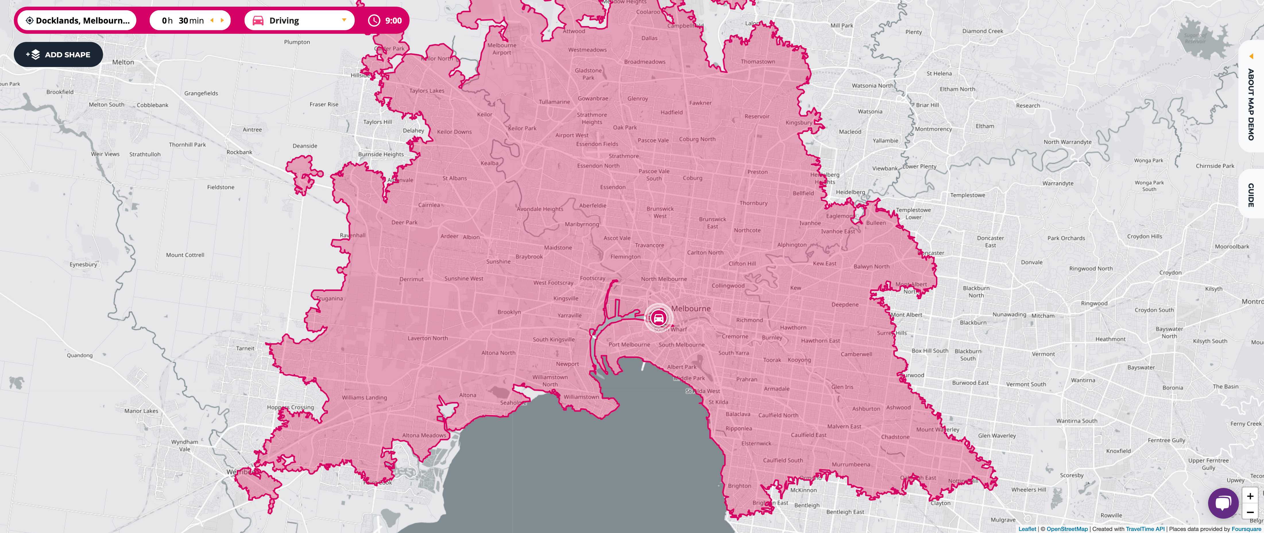
Narrow down the search scope
Figure 2: Boundaries of the reachable zone within 30mins driving time to the office during peak hours.
Suburbs within the boundary:
City of Melbourne
City of Port Phillip
City of Hobsons Bay
City of Stonnington
City of Glen Eira
City of Yarra
City of Moreland
City of Darebin
City of Maribyrnong
City of Moonee Valley
City of Boroondara
City of Bayside
After refining the search scope, the number of potentially suitable suburbs are reduced from 547 to 127.

Slide 9
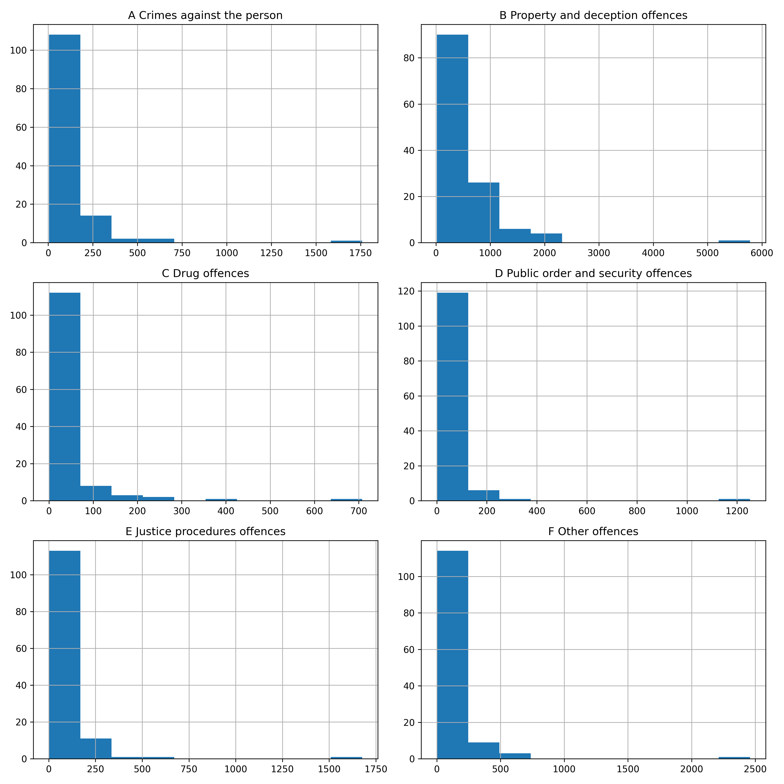
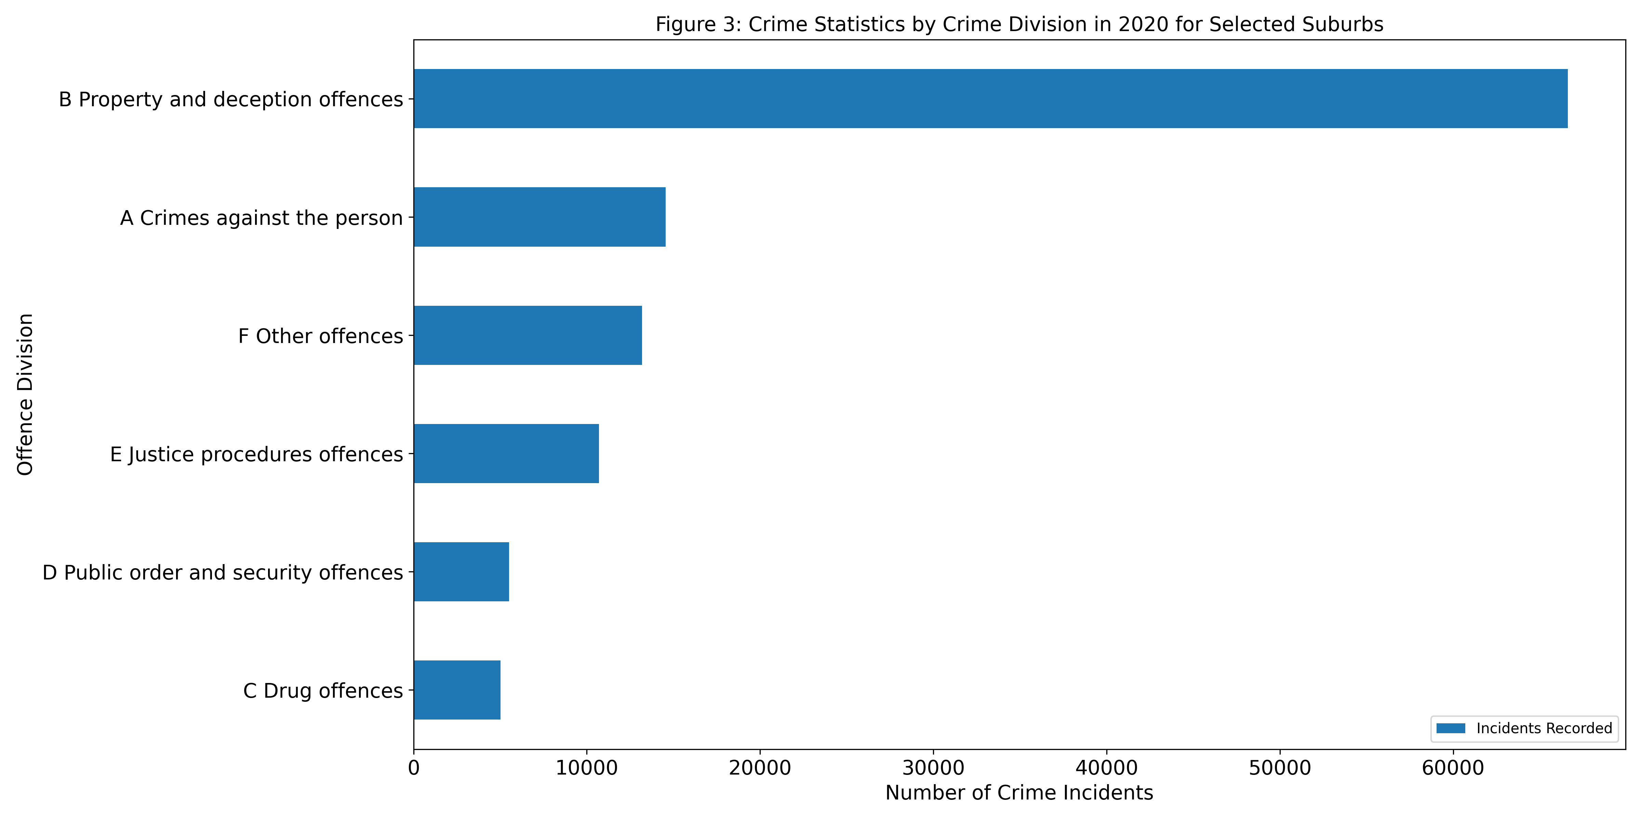
Distribution of Crime Incidents Grouped by Crime division in 2020

Slide 10
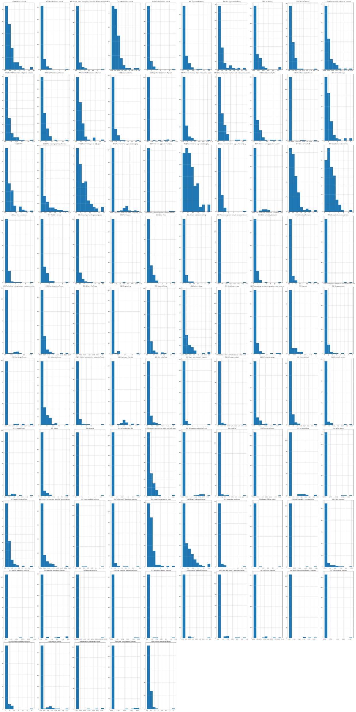
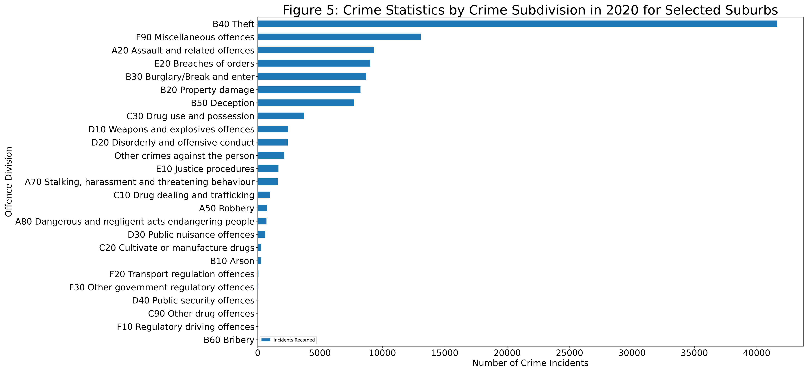
Distribution of Crime Incidents Grouped by Crime Subdivision in 2020

Slide 11
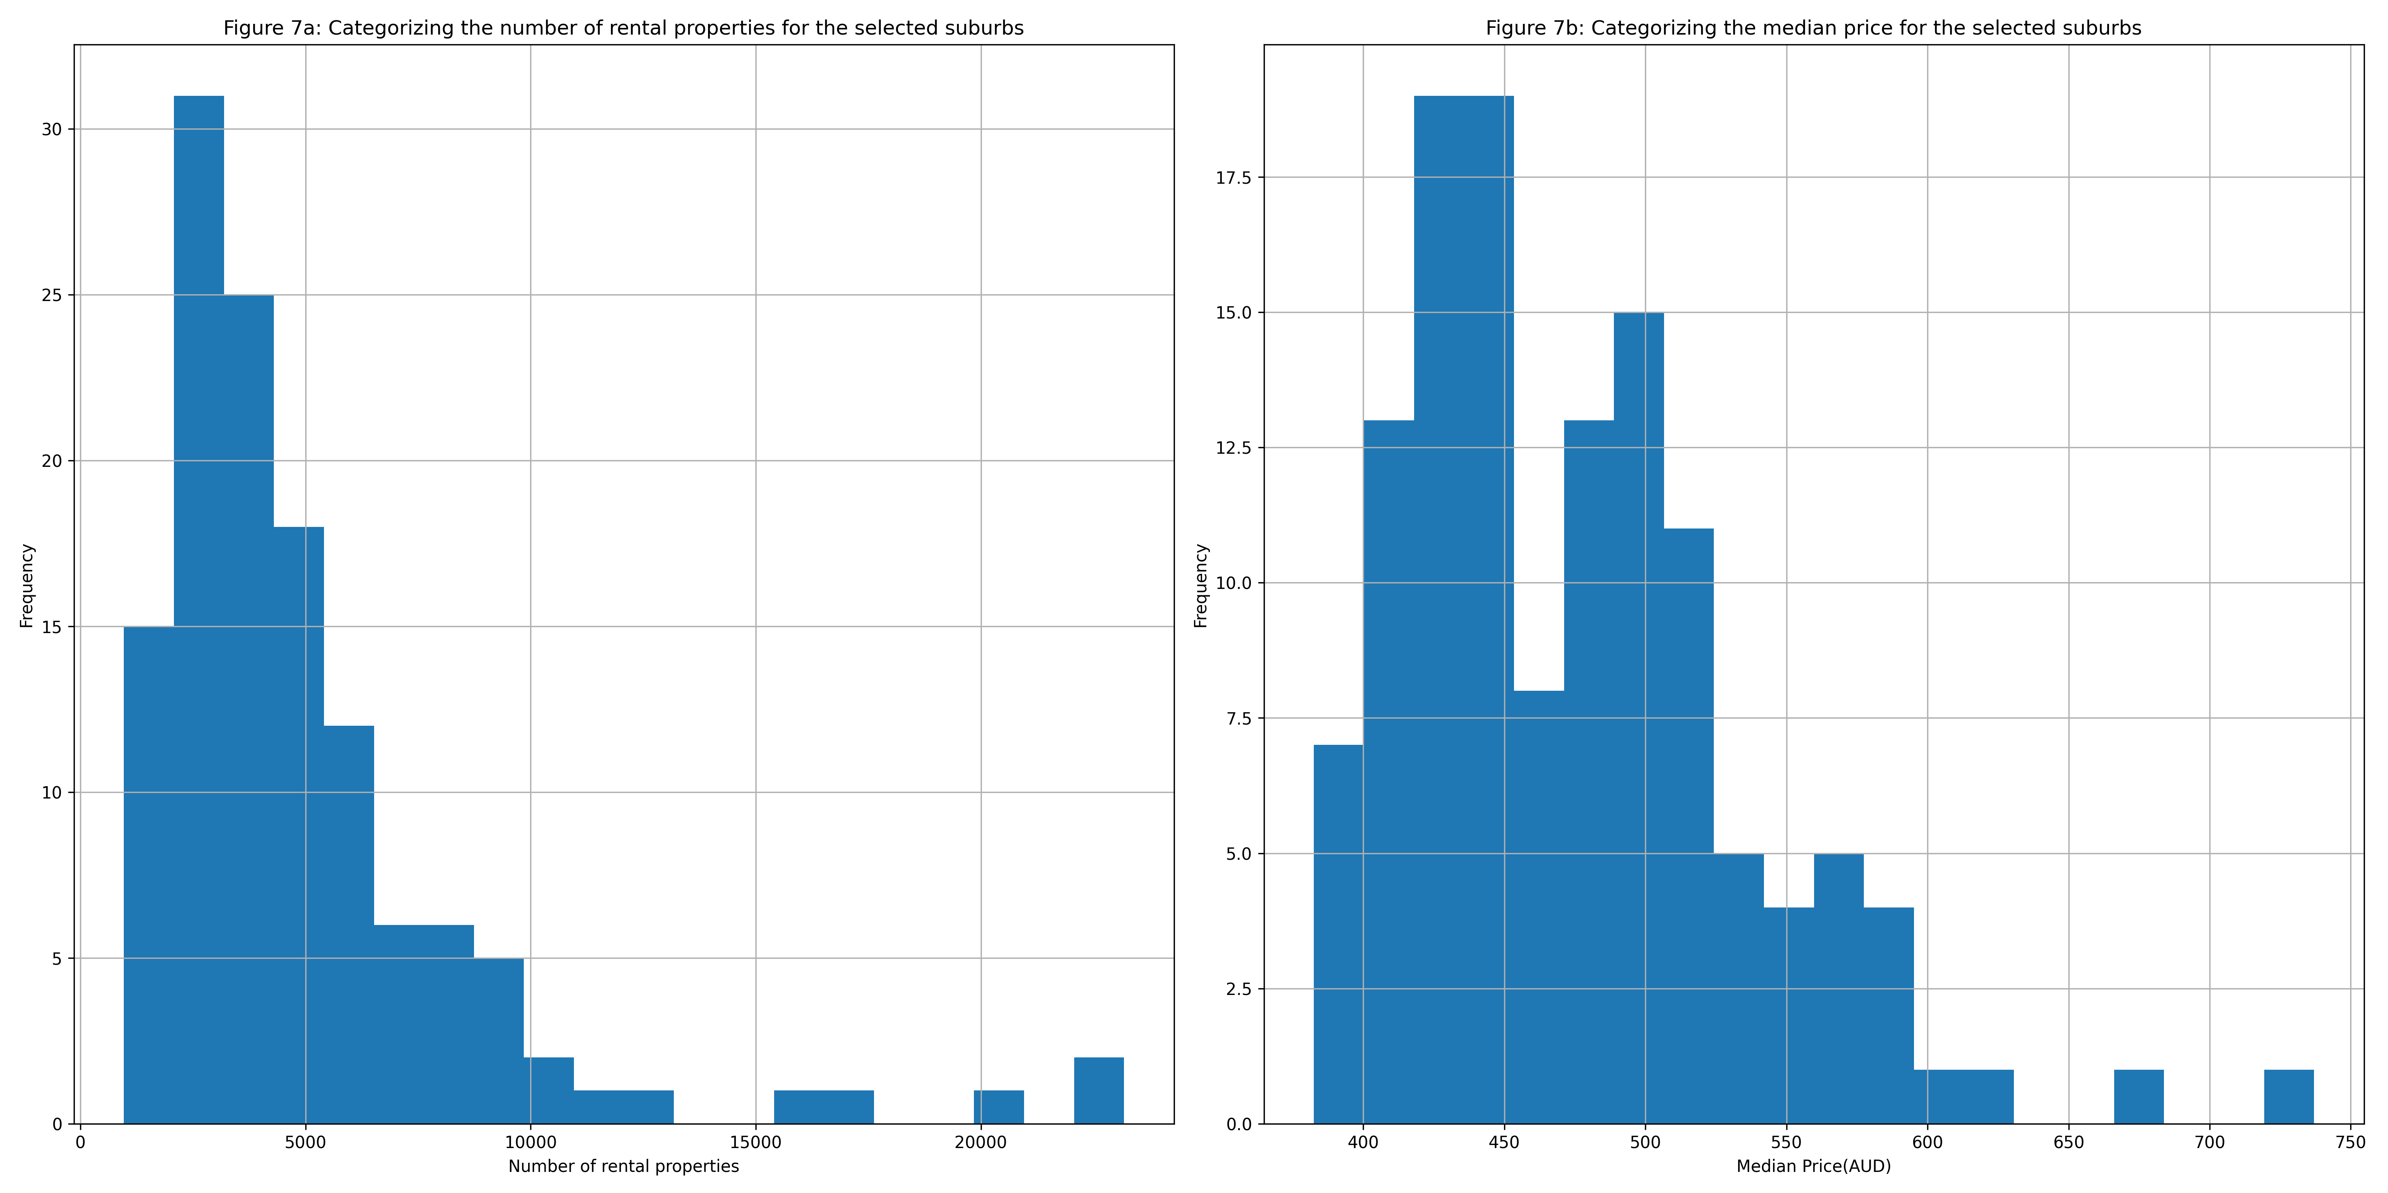
Distribution of Volume and Median Price of Rental Properties in 2020

Slide 12
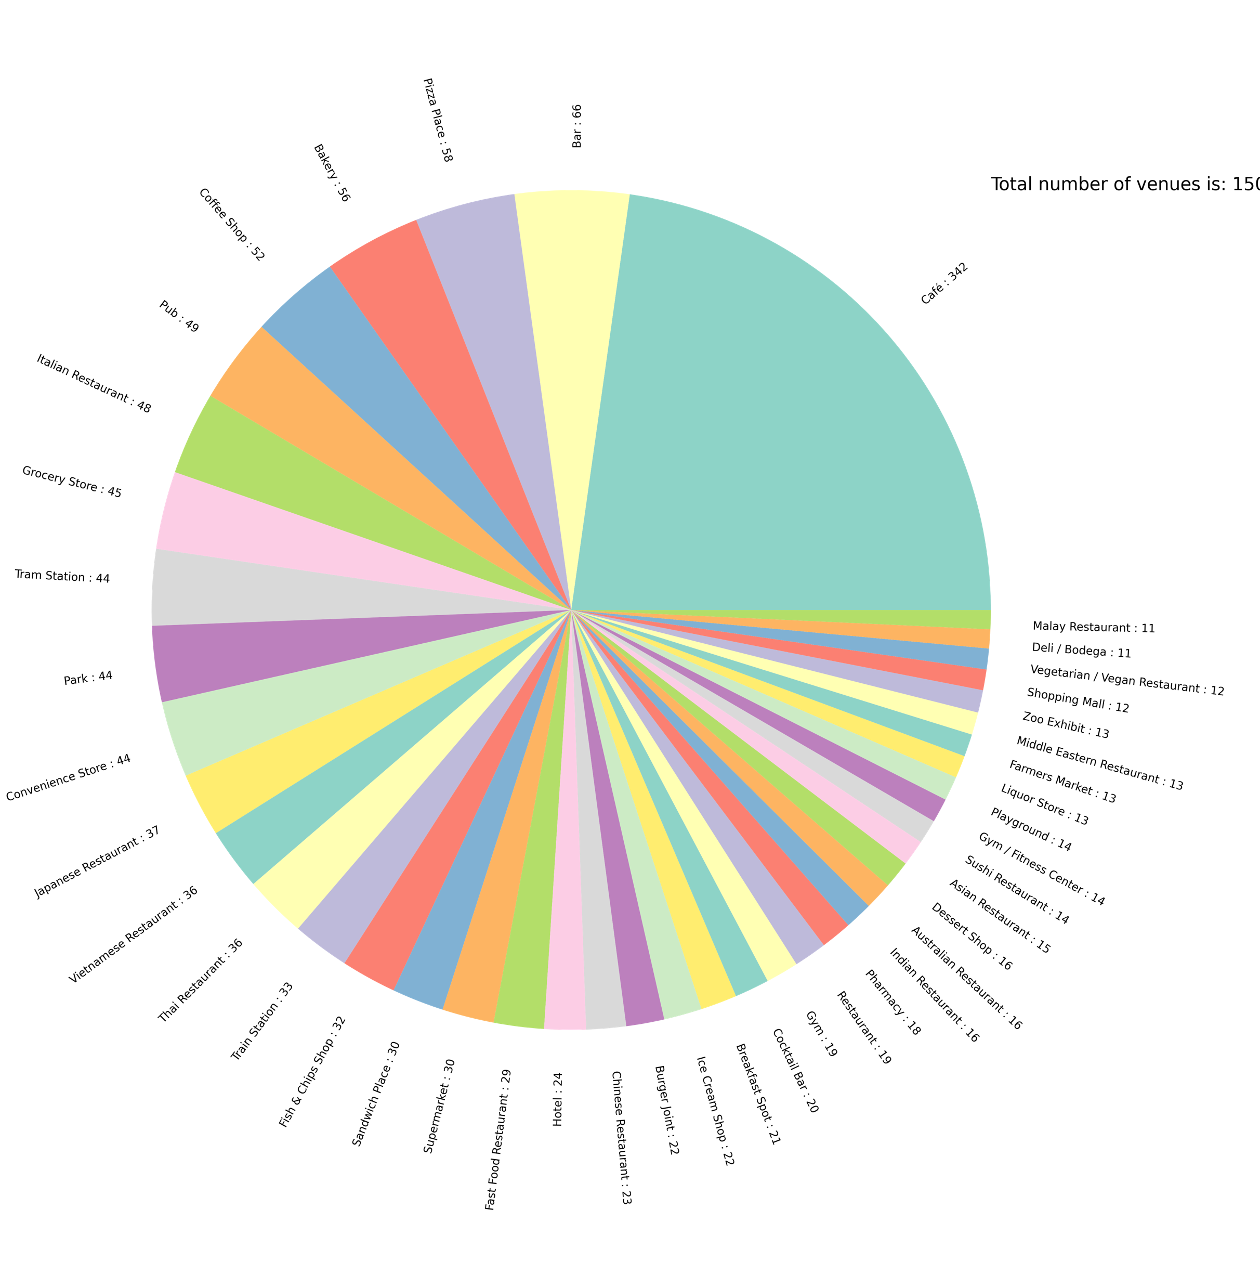
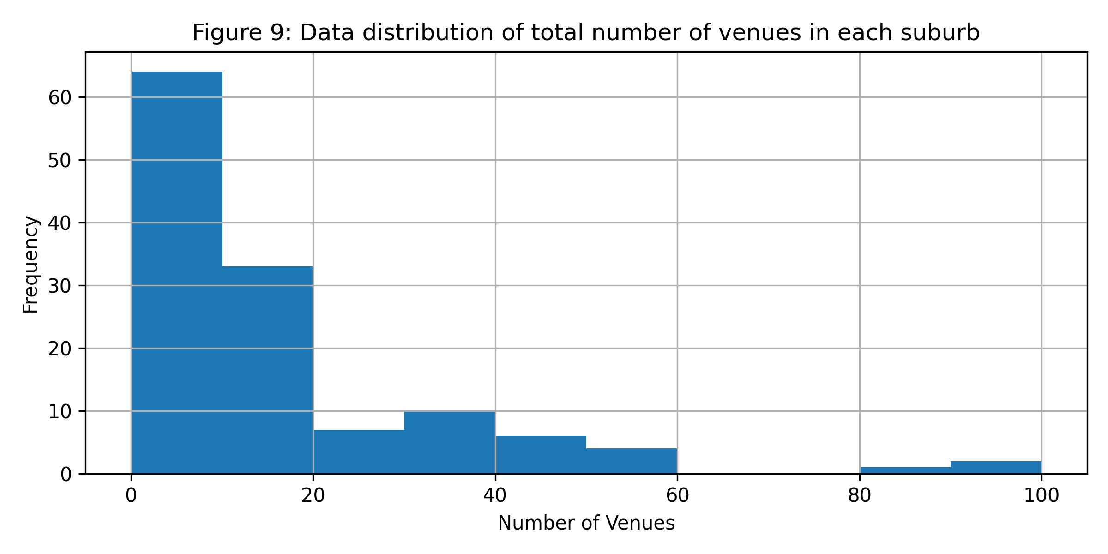
Major Venues

Slide 13
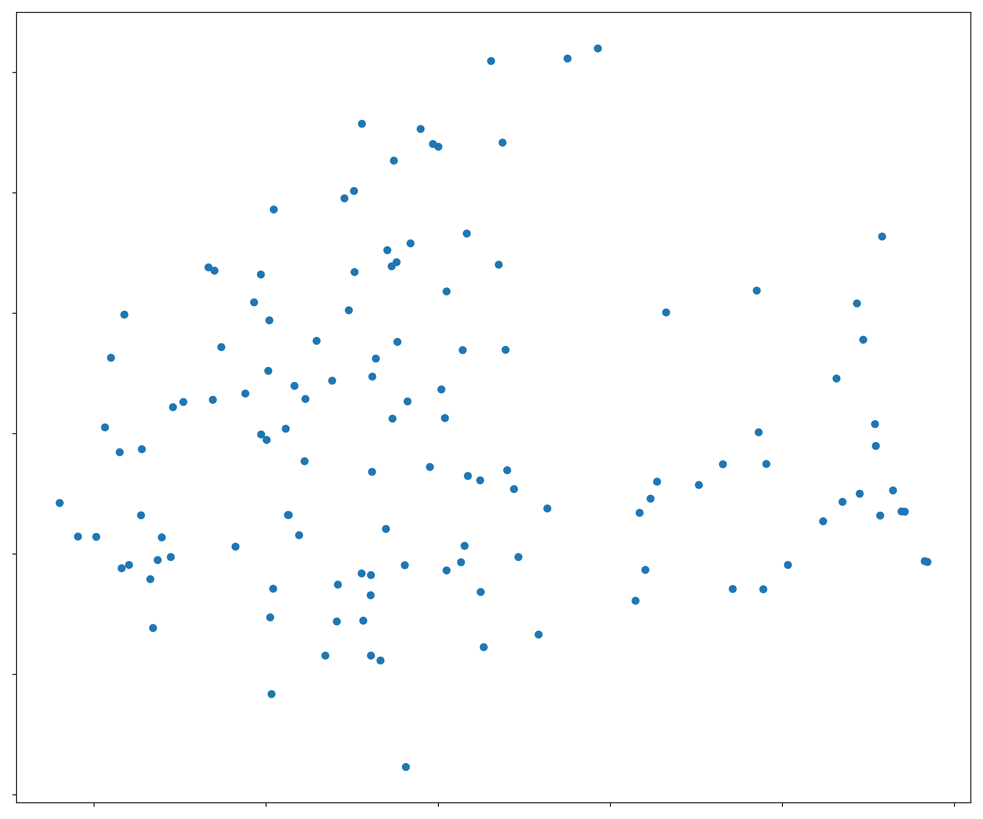
Prepare the Data for Training
Scaling
MaxAbsScaler()
All attributes are ranged between 0 and 1
Dimensionality Reduction
KernelPCA
Projected to a two-dimensional space
The Mean Squared Error is used to measure the reconstruction pre-image error.

Slide 14
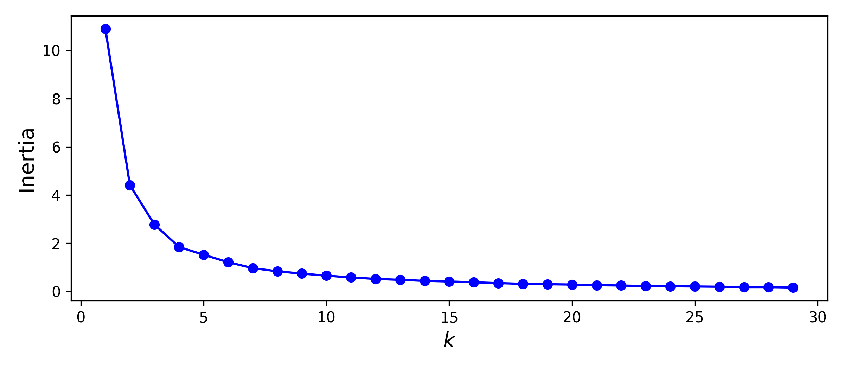
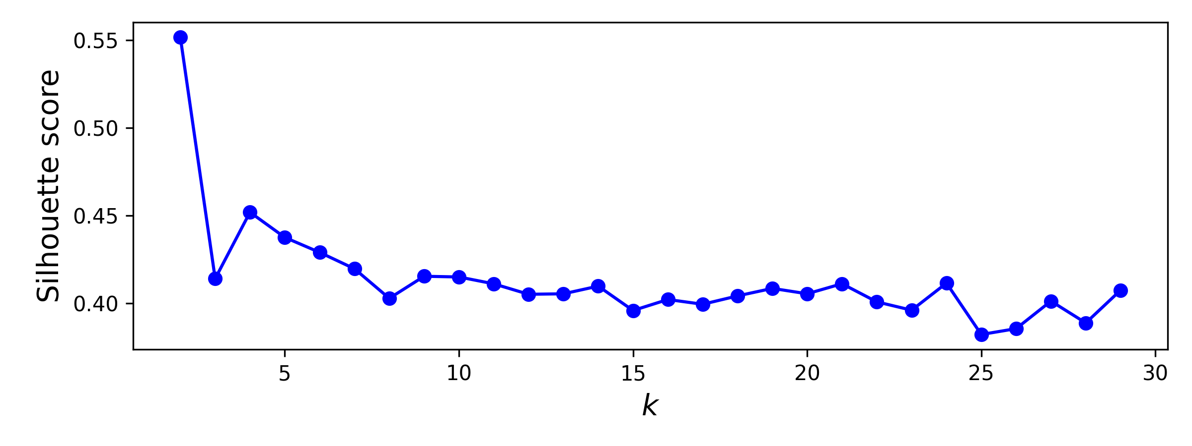
Find the best k value for K-Means Clustering
‘Elbow’ Method
Silhouette Score

Slide 15
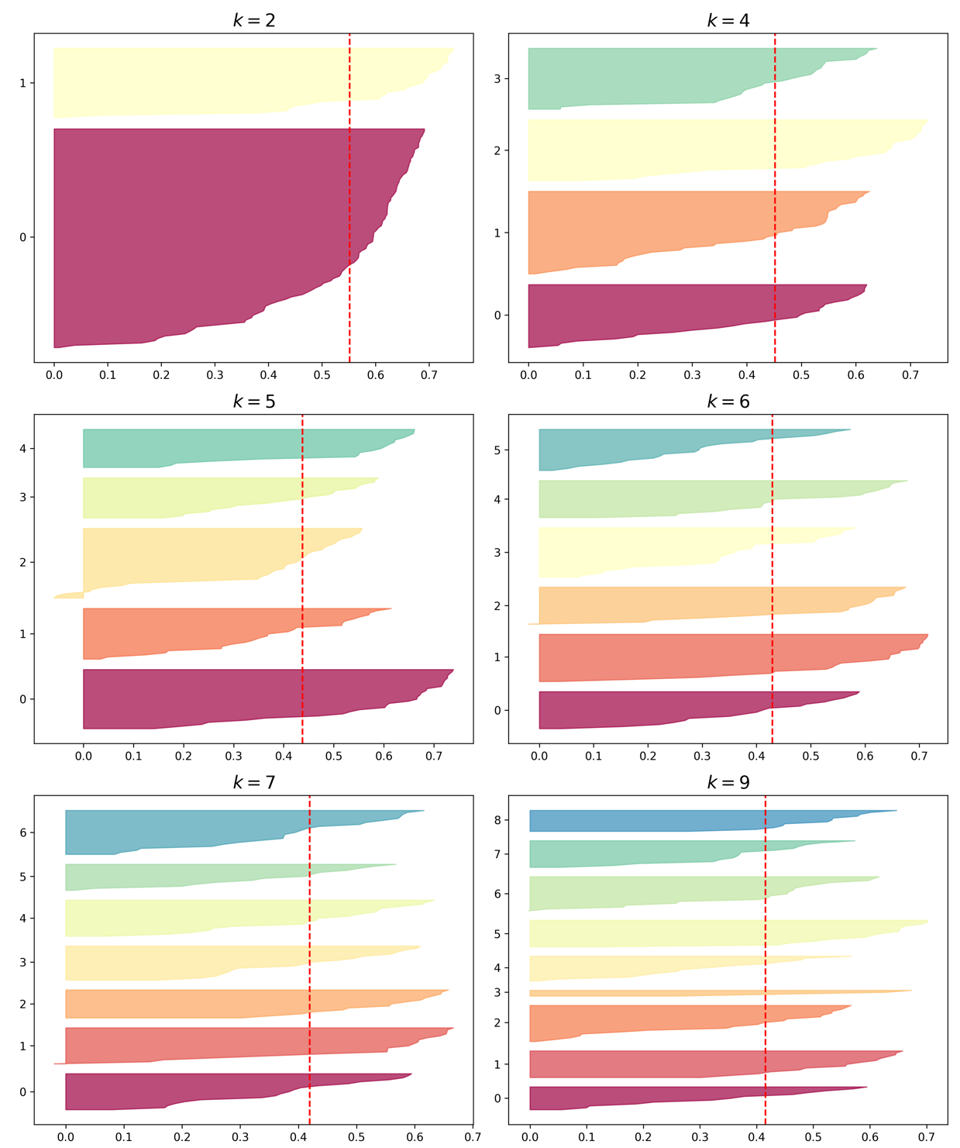
Silhouette Diagram
Silhouette coefficients of the instance in the cluster. The silhouette coefficient varies between -1 and 1.
+1 means the instance is well close to the centroid.
0 means the instance is at the boundary
-1 means the instance is assigned to the wrong cluster.

Slide 16
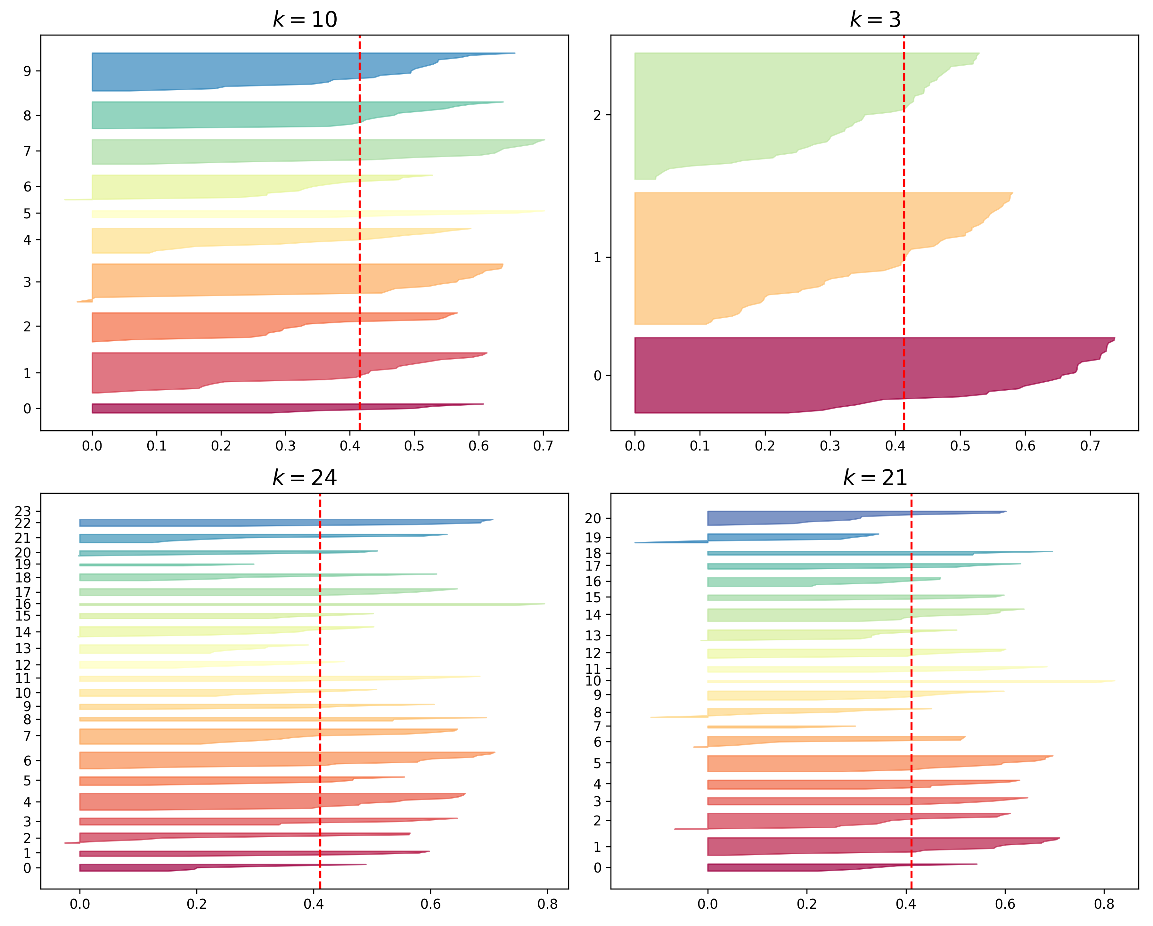
Silhouette Diagram (Cont.)
K=9
Silhouette coefficients of each cluster vastly outperform the overall silhouette score.
Evenly distributed clusters.
Although k=2 or k=4 has the higher silhouette score, k=9 is a better alternative to get the even dimension clusters.

Slide 17
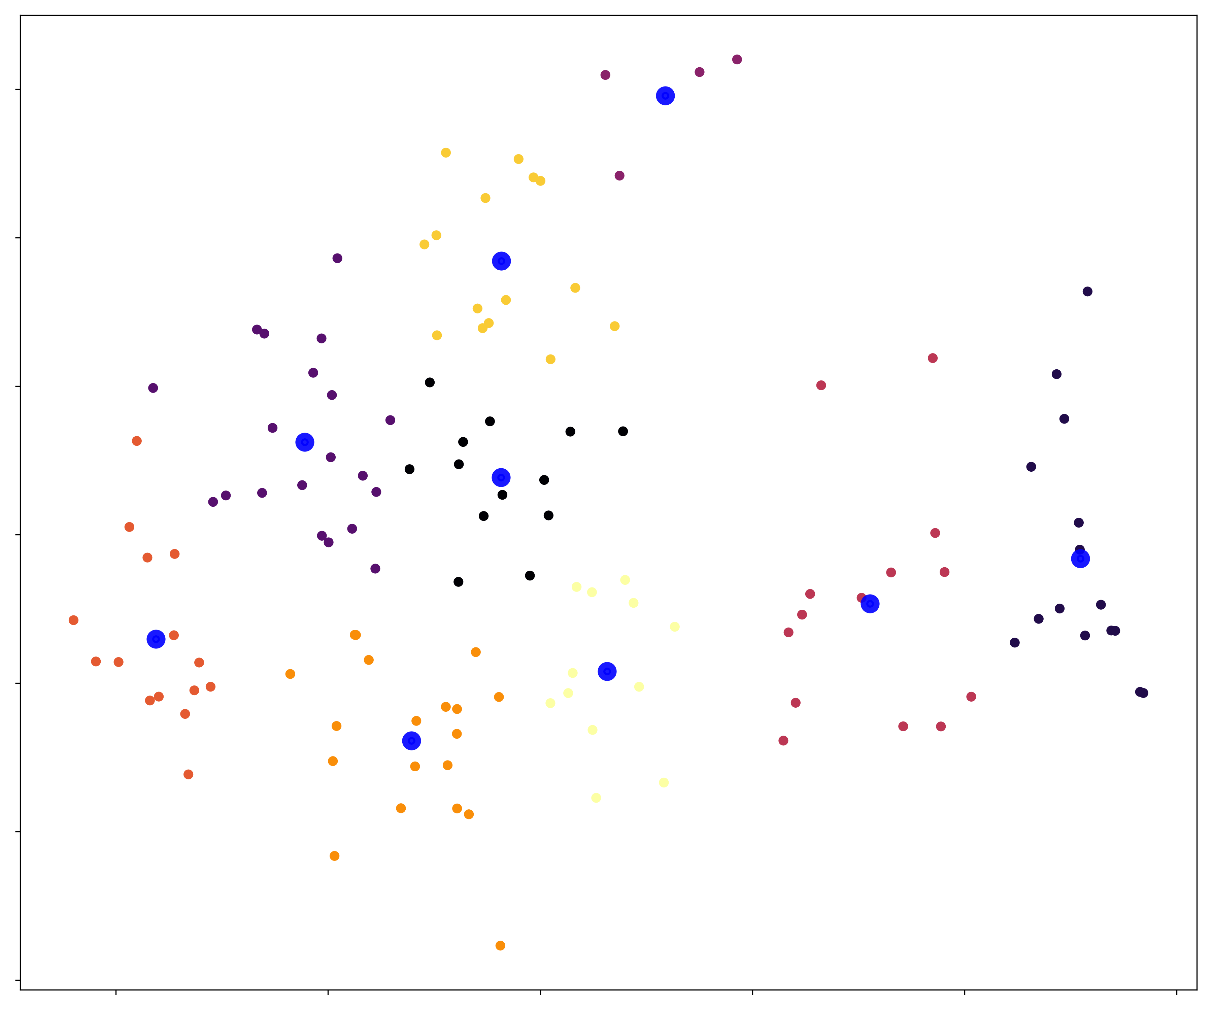
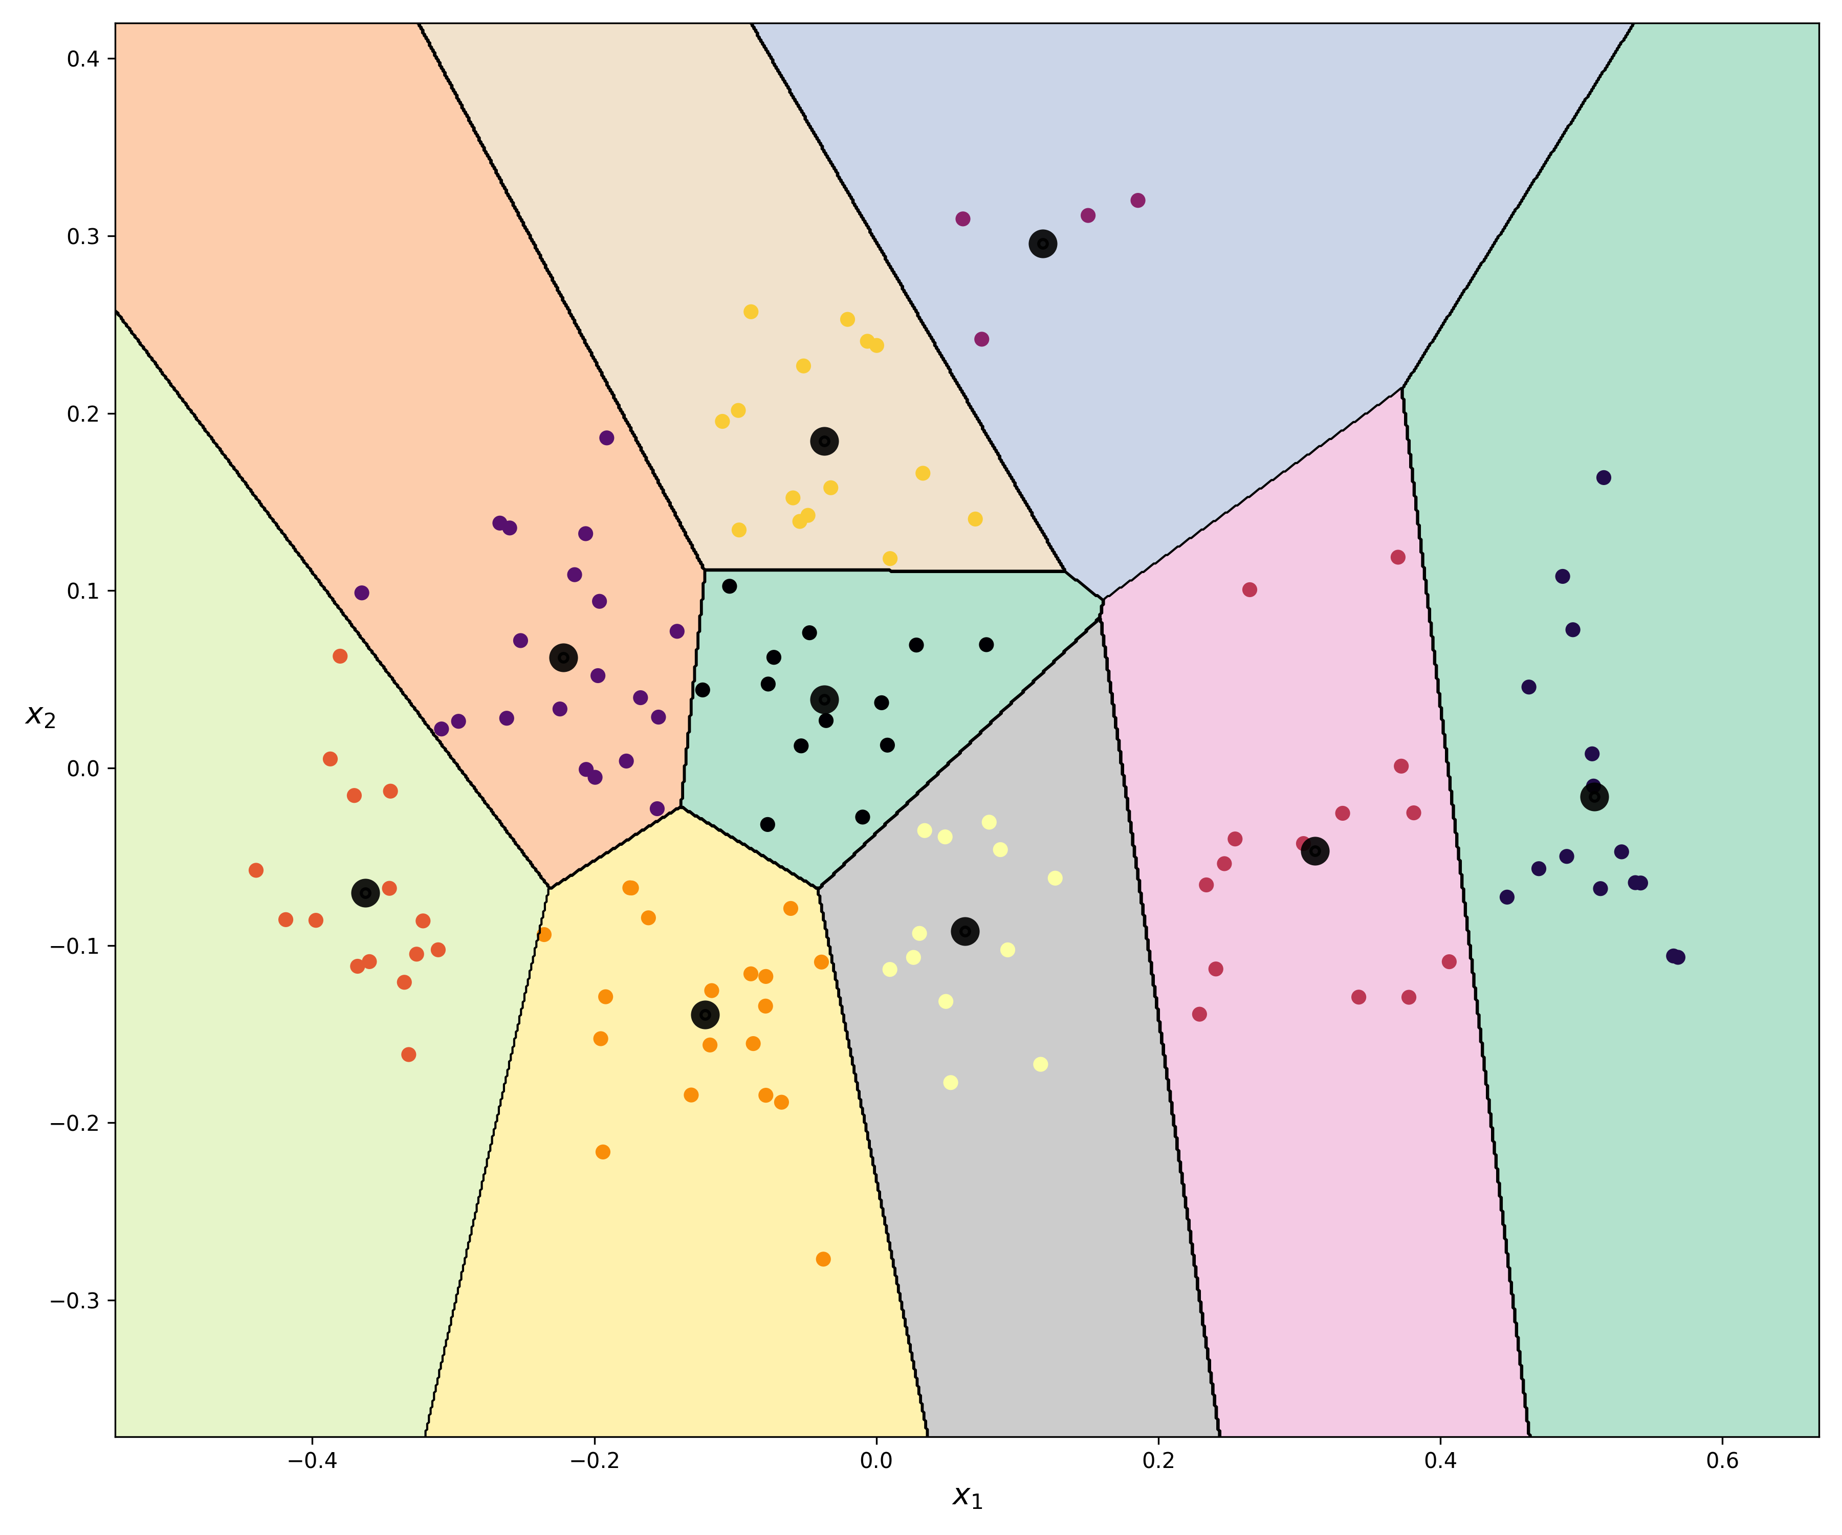
K-Means Clustering with optimal hyperparameters (K = 9)

Slide 18
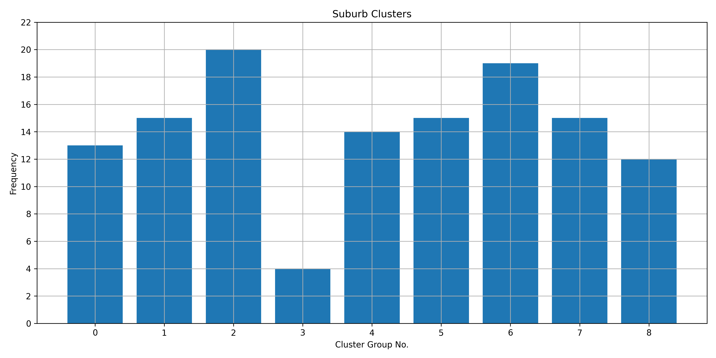
Feature Analysis - Distribution of suburbs in every cluster

Slide 19
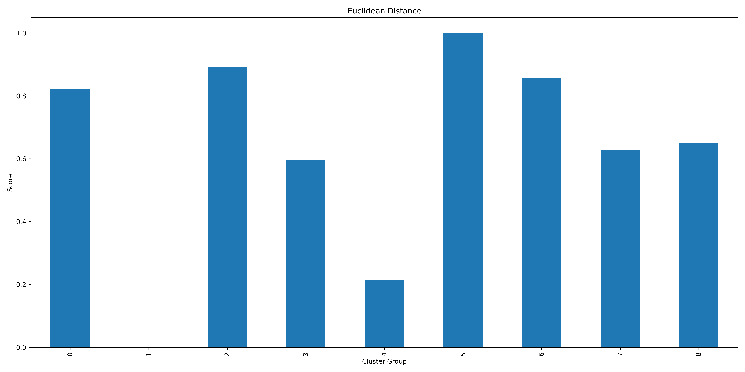
Feature Analysis - Average Euclidean distance to the office

Slide 20
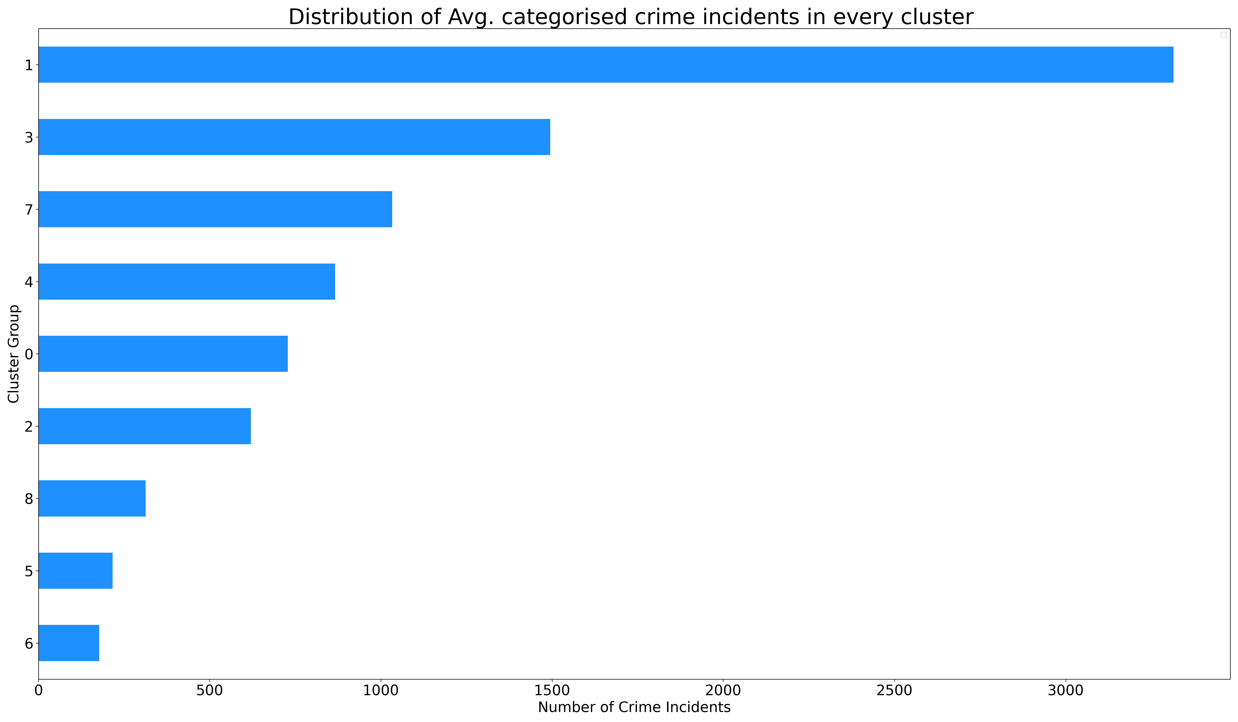
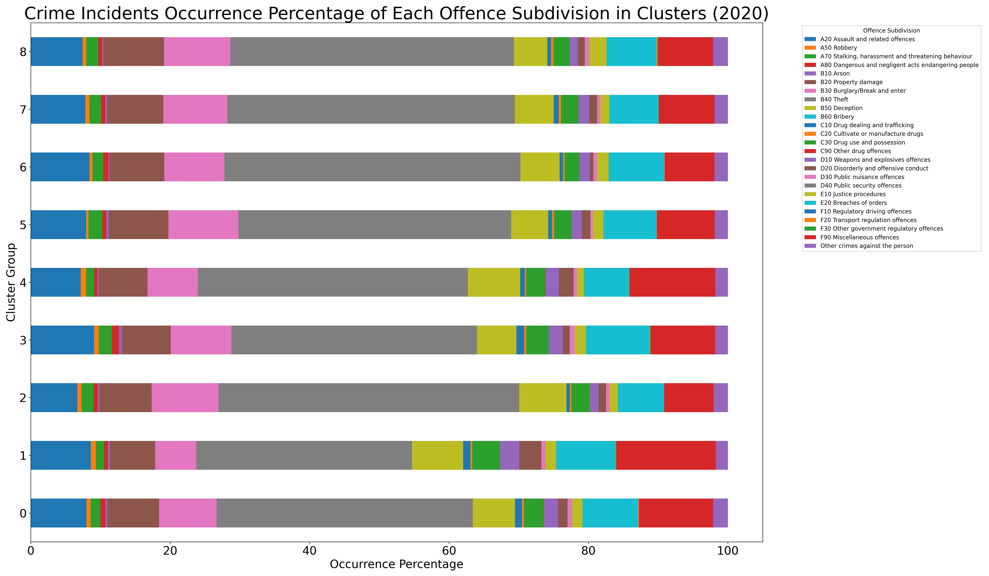
Feature Analysis - Crime distribution and occurrence

Slide 21
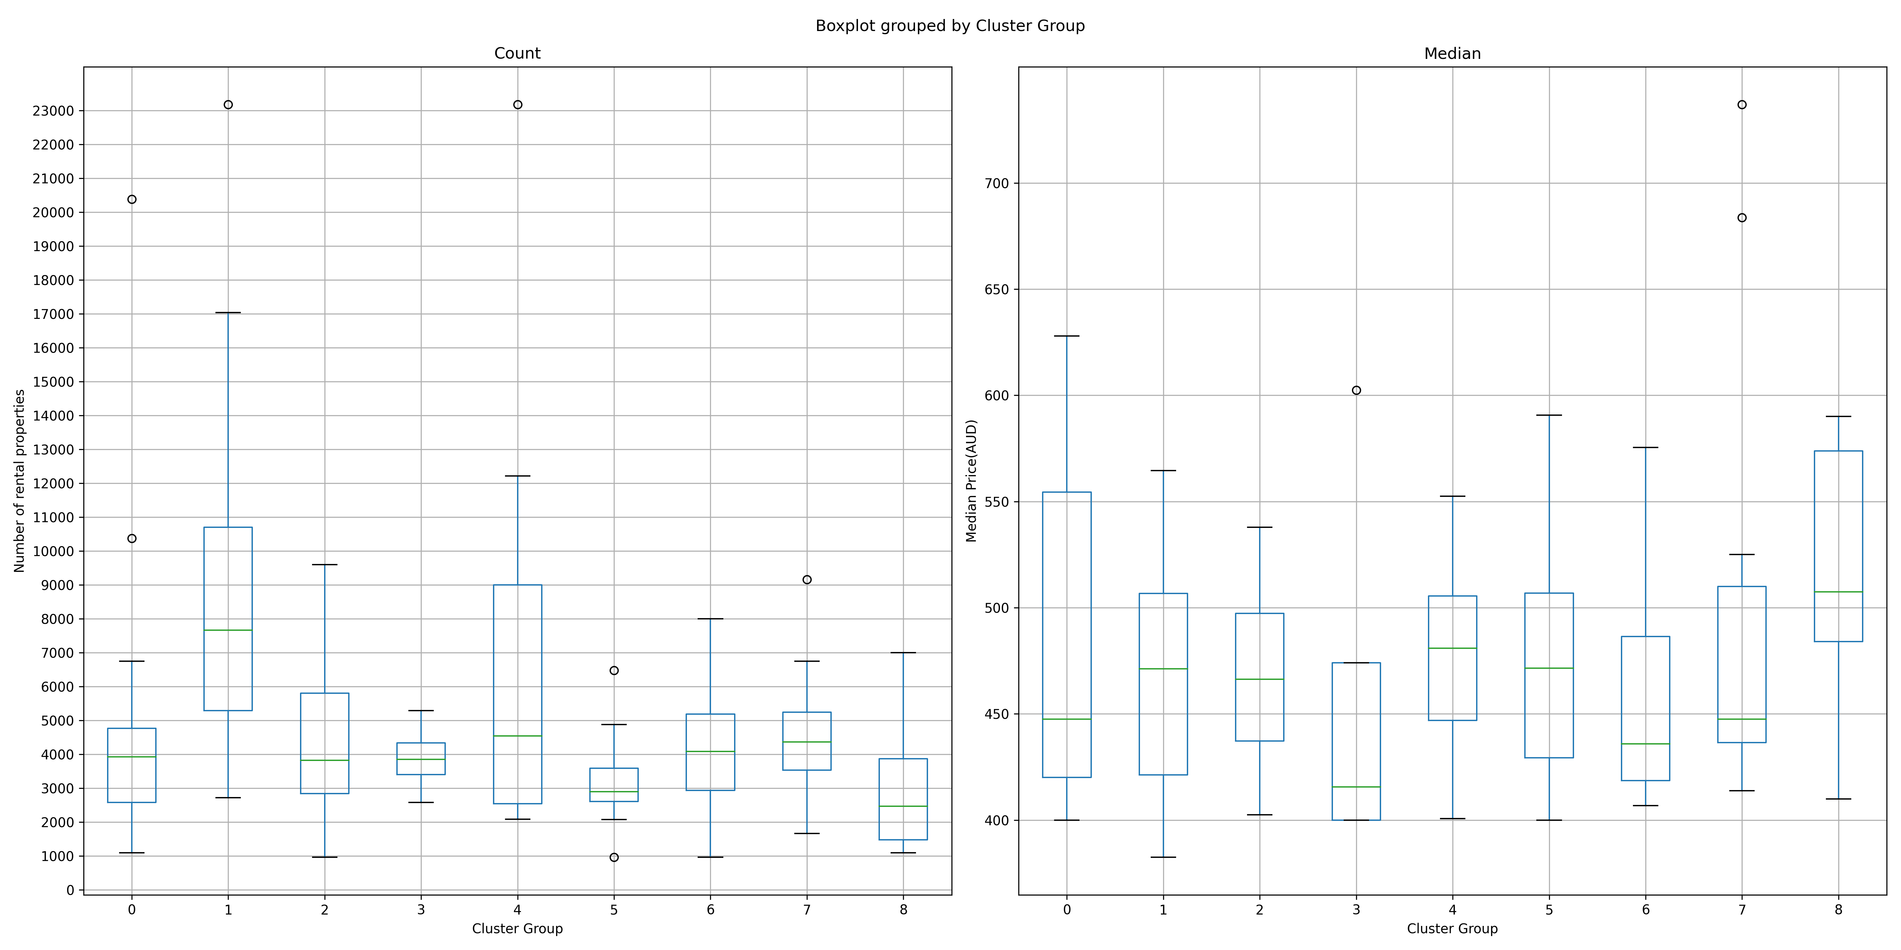
Feature Analysis - Rental boxplots

Slide 22
Cluster Profiles - Desired Attributes
Requirement 1
Euclidean distance
Requirement 2
Count
Median
Requirement 3
A20 Assault and related offences
A50 Robbery
A70 Stalking, harassment and threatening behaviour
A80 Dangerous and negligent act endangering people
B10 Arson
B20 Property damage
B30 Burglary/Break and enter
B40 Theft
Requirement 4
Food place
Café
Leisure
Shopping
Transport

Slide 23
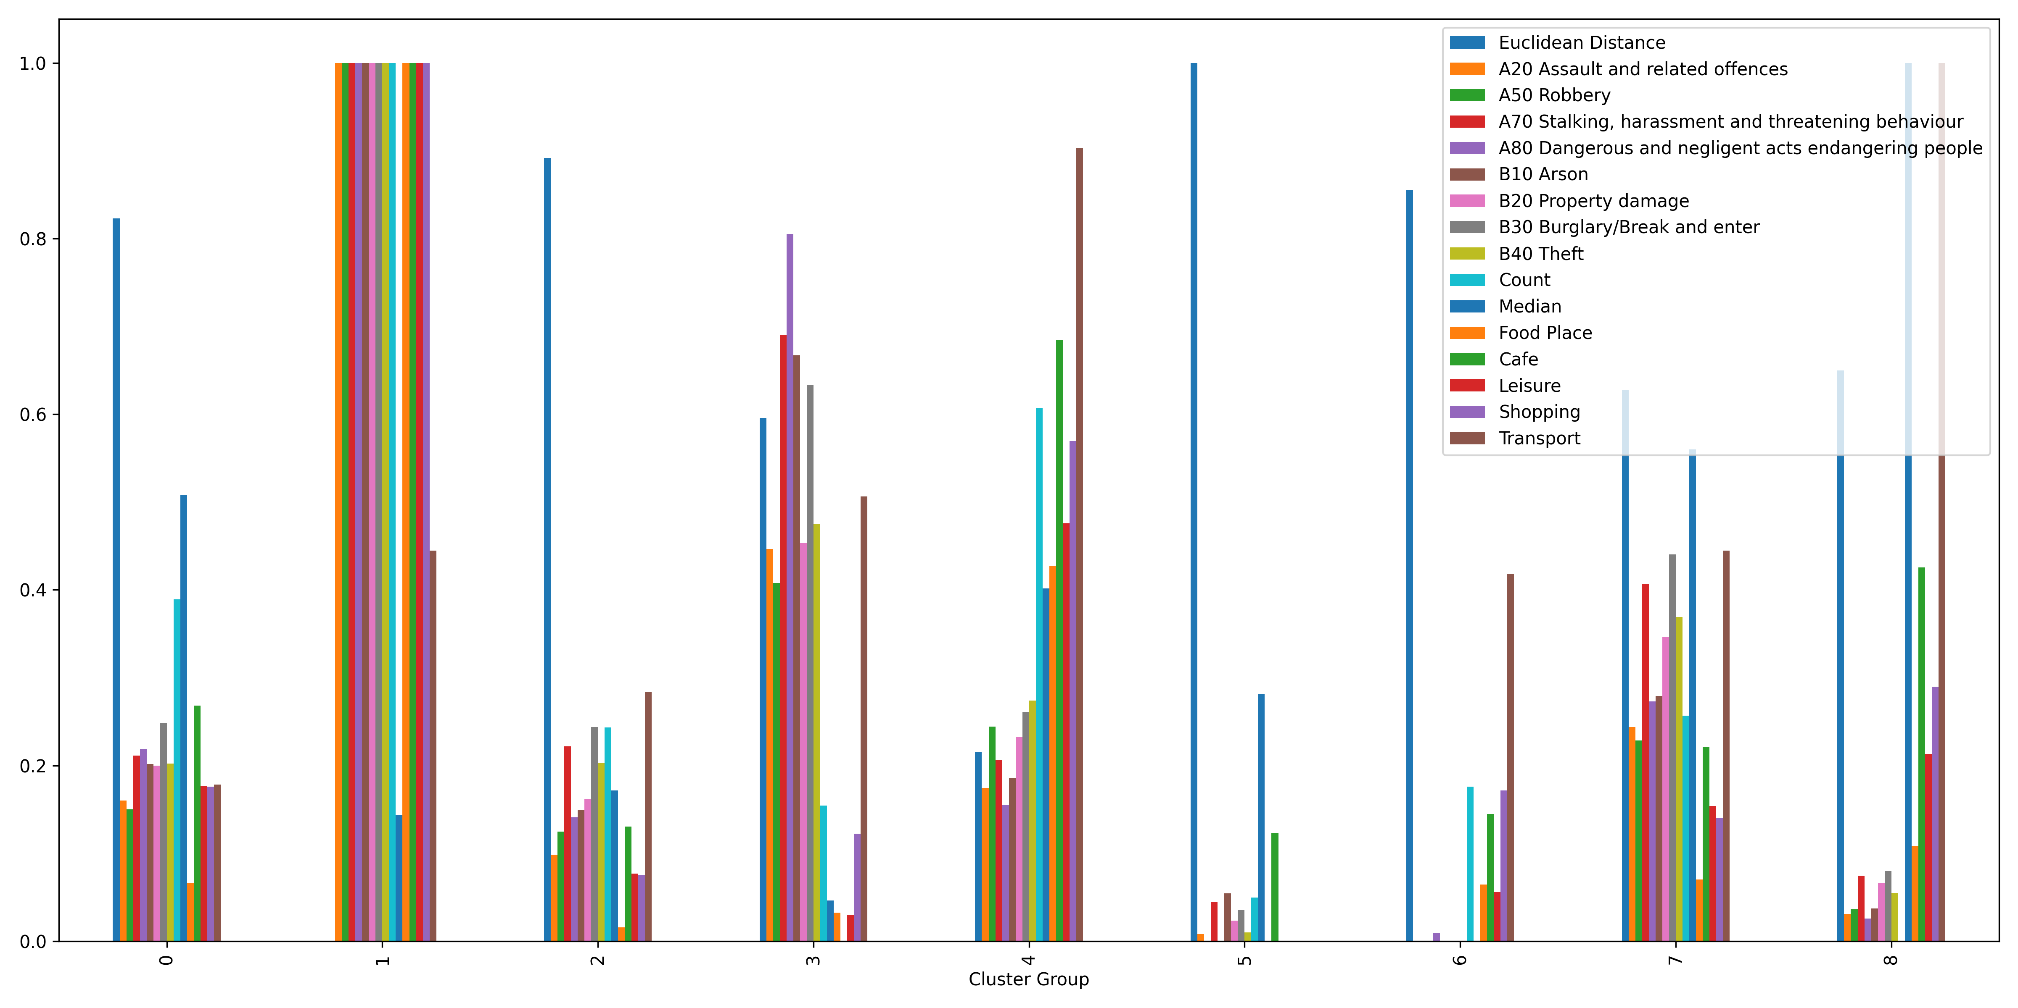
Cluster Features -Overview

Slide 24
Cluster Features -Euclidean Distance

Slide 25
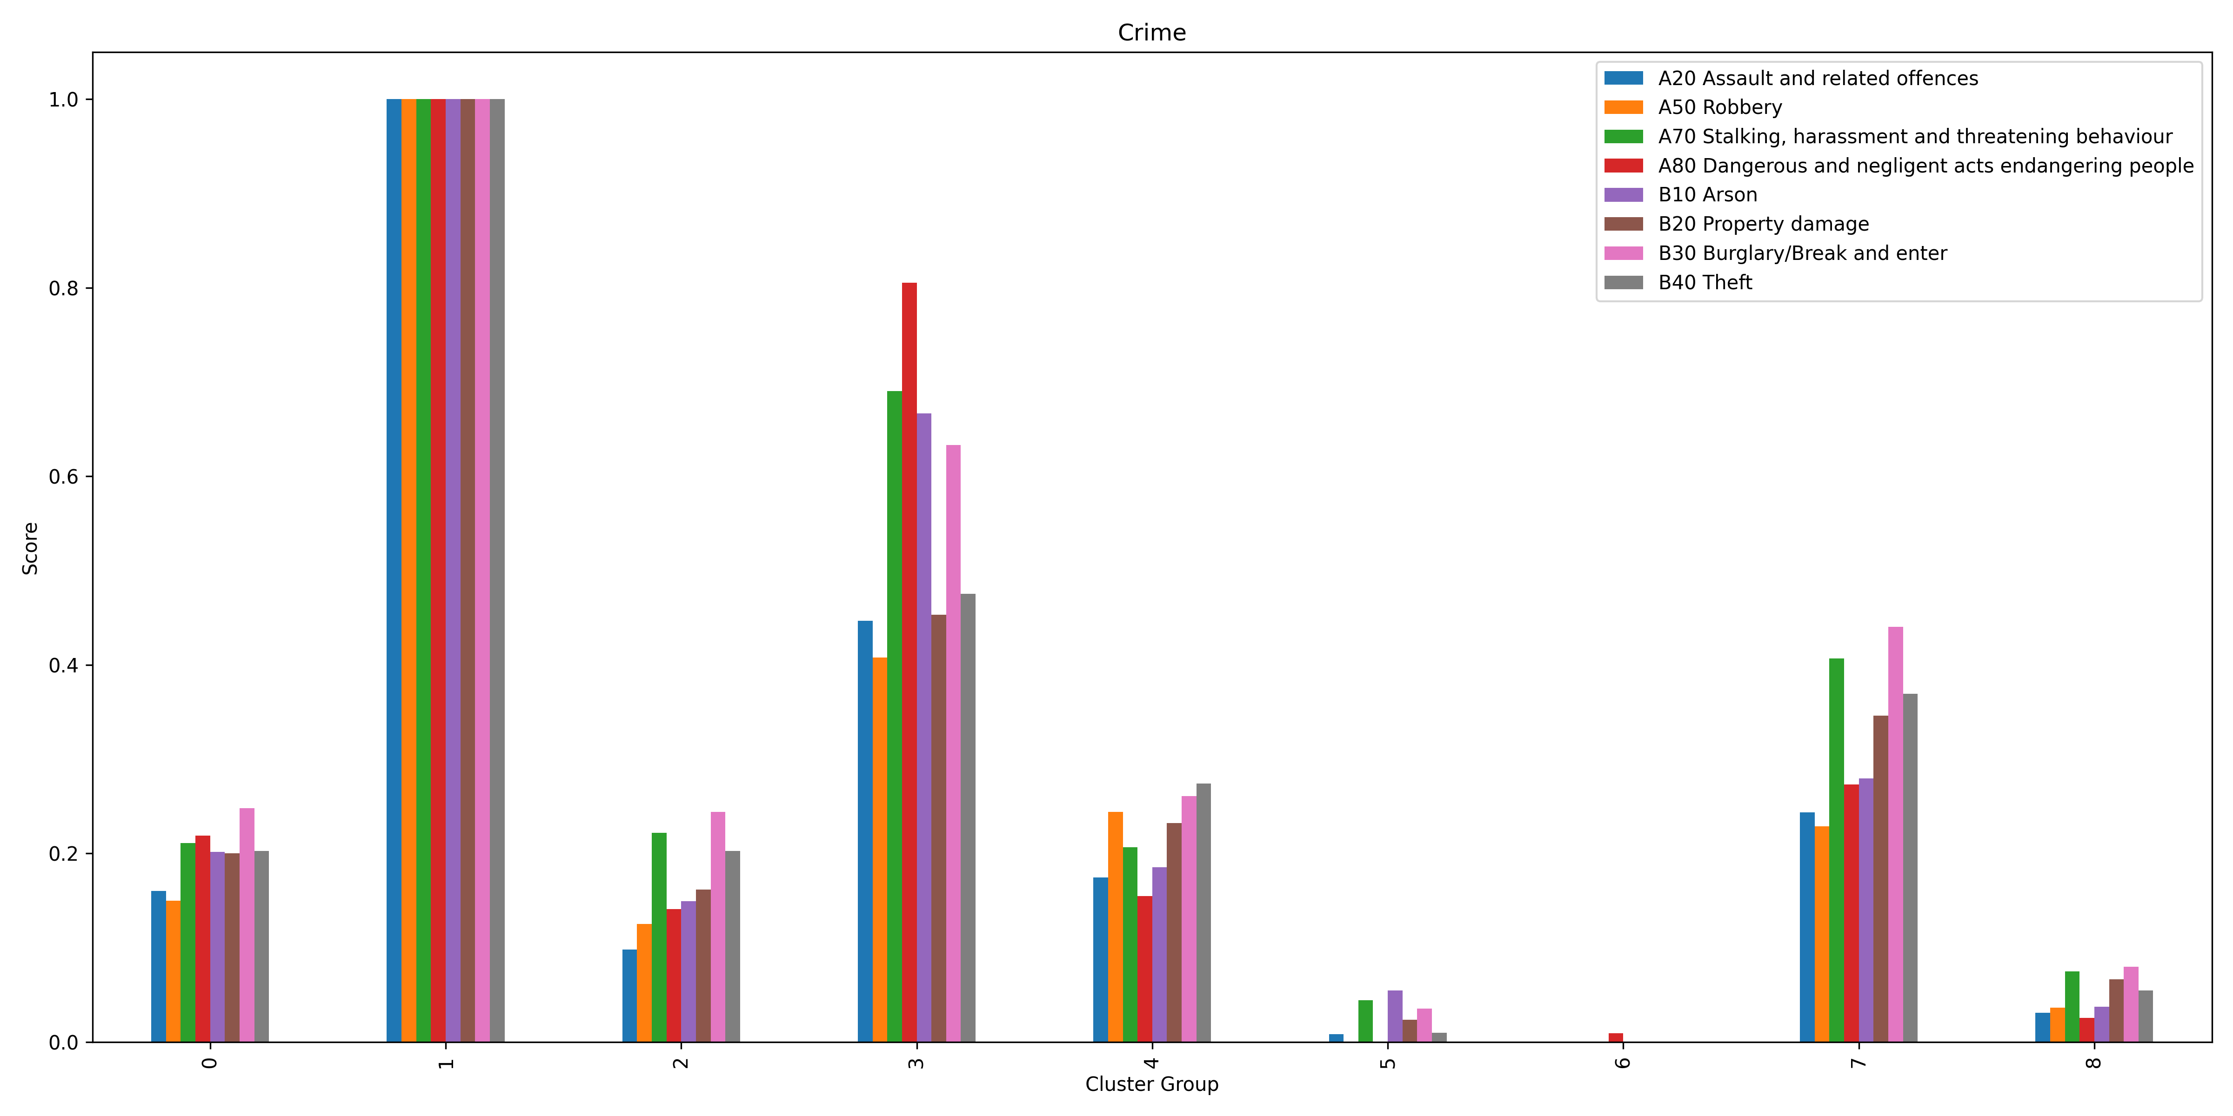
Cluster Features -Crime

Slide 26
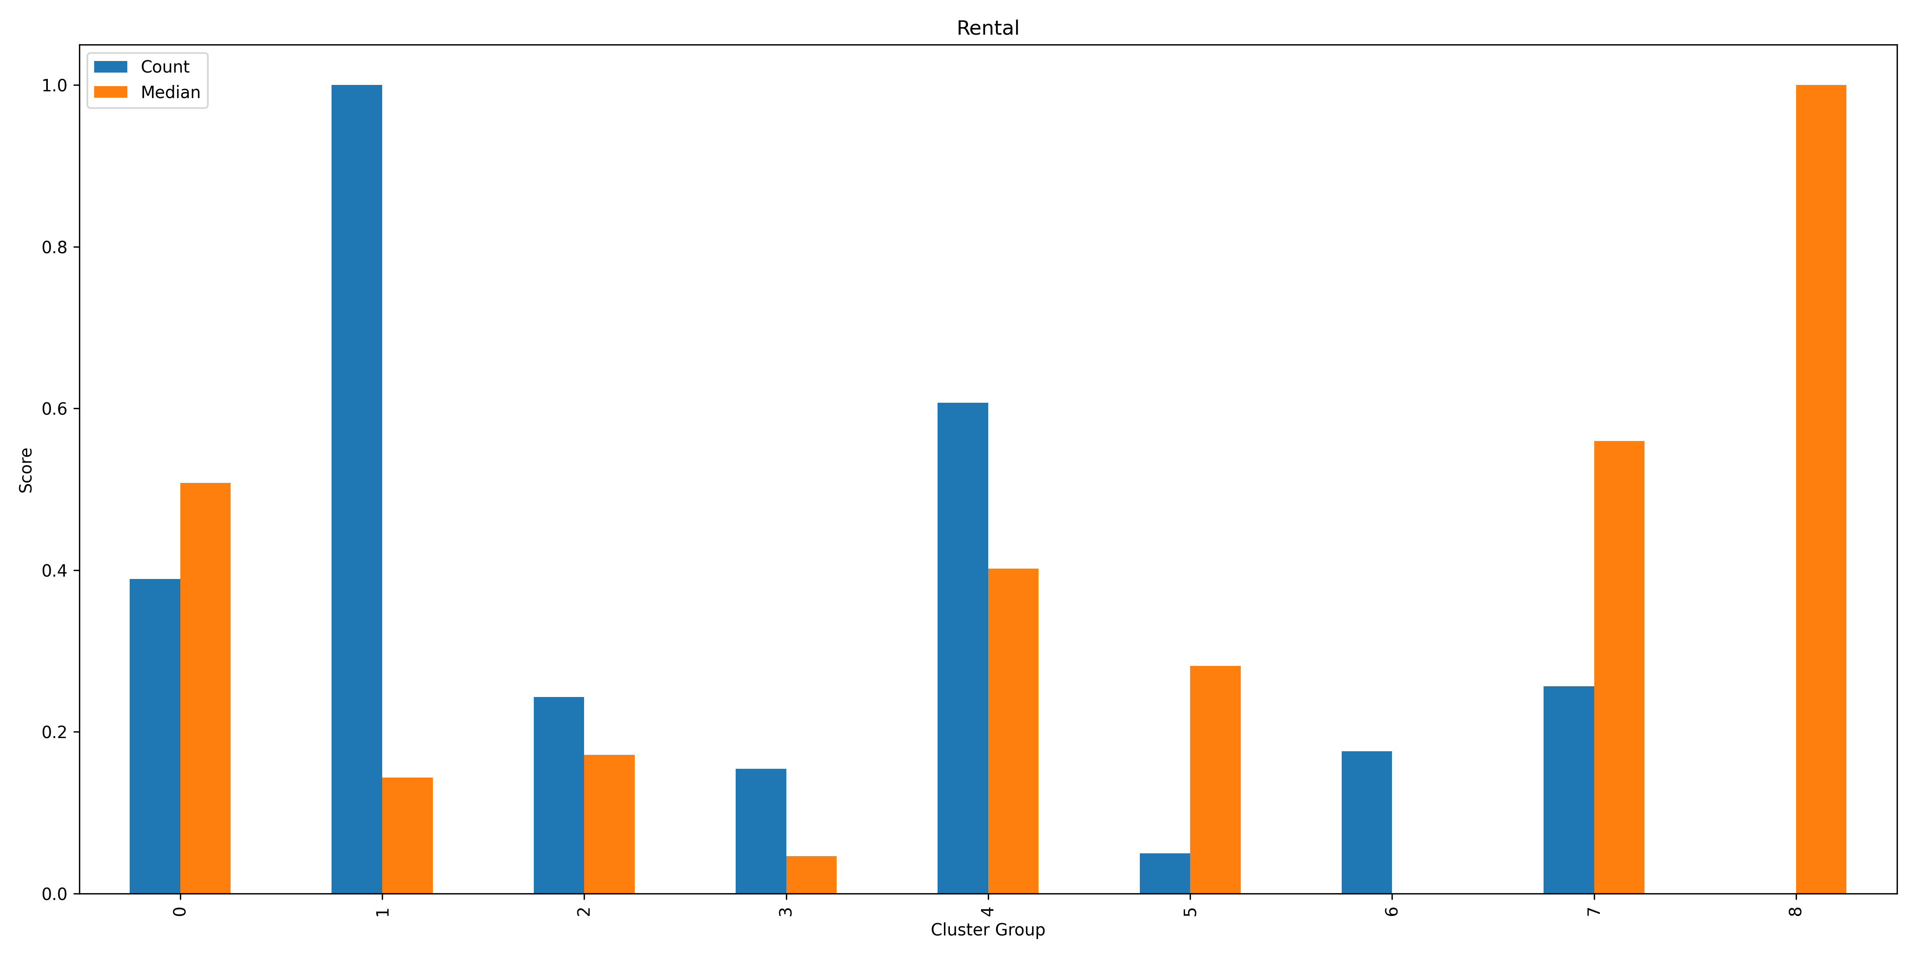
Cluster Features -Rental

Slide 27
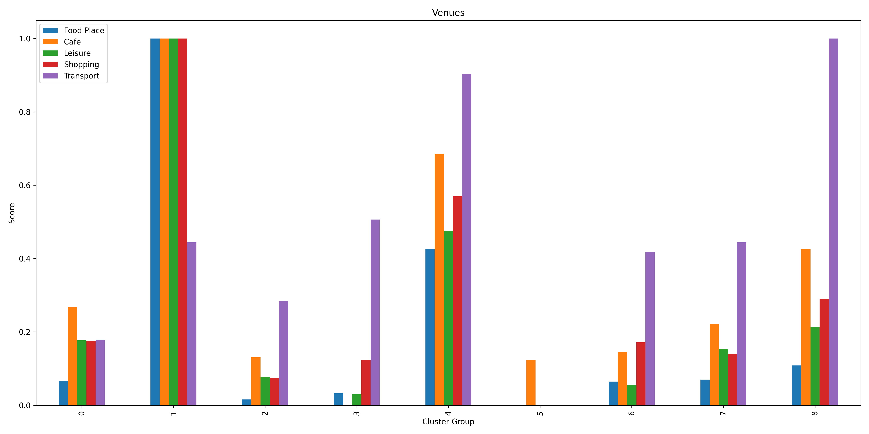
Cluster Features -Venue

Slide 28
Cluster Profiles - Cluster 0
Profile:
This cluster consists of suburbs possessing median stats across most sectors.
Commute
Driving time: 20~30mins
Public Transportation Accessibility : Difficult
Crime
Assaulting class: Low
Crimes could induce assaulting action against person: Low on average
Rental
Volume: Moderate
Median Price: Moderate
Venue
Variety: Moderate
Volume: Low
Top three most popular venues : cafés, coffee shops, and supermarkets.

Slide 29
Cluster Profiles - Cluster 1
Profile:
The suburbs found in Cluster 1 are highly commercialised, well entertained, yet, they have the highest crime rates on average across every crime category.
Commute
Driving time: Less than 5mins
Public Transportation Accessibility : Moderate
Crime
Assaulting class: Highest
Crimes could induce assaulting action against person: Highest
Rental
Volume: Highest
Median Price: Low
Venue
Variety: Highest
Volume: Highest
Top three most popular venues : cafés, bars, and Vietnamese restaurants.

Slide 30
Cluster Profiles - Cluster 2
Profile:
In this cluster, the suburbs are 'quiet and remote’.
Commute
Driving time: 25~30mins
Public Transportation Accessibility : Difficult to Median
Crime
Assaulting class: Low
stalking, harassment, and threatening behaviour is significant
Crimes could induce assaulting action against person: Low on average
Rental
Volume: Low
Median Price: Low
Venue
Variety: Limited
Volume: Low
Top three most popular venues : cafés, parks, and Pizza places.

Slide 31
Cluster Profiles - Cluster 3
Profile:
The high crime rate could be a concern for these suburbs in this cluster.
Commute
Driving time: 15~20mins
Public Transportation Accessibility : Median
Crime
Assaulting class: Above Median
Dangerous and negligent acts endangering people is significant
Crimes could induce assaulting action against person: Above Median
Rental
Volume: Low
Median Price: Low
Venue
Variety: Monotonous
Volume: Low
Top three most popular venues : ice cream shops, vintage stores, bakeries.

Slide 32
Cluster Profiles - Cluster 4
Profile:
The suburbs classified in this cluster are very well balanced in every sector.
Commute
Driving time: 10~15mins
Public Transportation Accessibility : Convenient
Crime
Assaulting class: Low on average
The most frequent crimes are theft, burglary, break and entry, and robbery.
Crimes could induce assaulting action against person: Low on average
Rental
Volume: Median to High
Median Price: Low to Median
Venue
Variety: Comprehensive
Volume: Median to High
Top three most popular venues : cafés, coffee shops, zoo exhibits.

Slide 33
Cluster Profiles - Cluster 5
Profile:
This cluster contains suburbs that have the lowest numbers in both crime rates and rental prices on averages.
Commute
Driving time: Close to 30mins
Public Transportation Accessibility : Inaccessible
Crime
Assaulting class: Very low on average
Crimes could induce assaulting action against person: Very low on average
Rental
Volume: Low
Median Price: Low to Median
Venue
Variety: Monotonous
Volume: Low
Top three most popular venues : cafés, pizza places, bakeries.

Slide 34
Cluster Profiles - Cluster 6
Profile:
This cluster contains suburbs that have the lowest numbers in both crime rates and rental prices on averages.
Commute
Driving time: 15~20mins
Public Transportation Accessibility : Moderate
Crime
Assaulting class: Lowest on average
Crimes could induce assaulting action against person: Lowest on average
Rental
Volume: Low
Median Price: Lowest
Venue
Variety: Limited to Moderate
Volume: Low
Top three most popular venues : cafés, fast food restaurants, and bakeries.

Slide 35
Cluster Profiles - Cluster 7
Profile:
The character of this cluster is the high crime rate in conjunction with a high average rental price.
Commute
Driving time: 15~20mins
Public Transportation Accessibility : Moderate
Crime
Assaulting class: Low to Moderate
Stalking, harassment, and threatening behaviour is significant
Burglary, and break and entry is relatively high
Crimes could induce assaulting action against person: Moderate on average
Rental
Volume: Low to Median
Median Price: Moderate to High
Venue
Variety: Moderate
Volume: Low
Top three most popular venues : cafés, convenience stores, and Italian restaurants.

Slide 36
Cluster Profiles - Cluster 8
Profile:
This cluster consists of suburbs possessing extremely high average rental prices with the best-ranking accessibility to public transportation.
Commute
Driving time: 15~20mins
Public Transportation Accessibility : The Most Convenient
Crime
Assaulting class: Low on average
Criminal activities are evenly distributed across crime categories
Crimes could induce assaulting action against person: Low on average
Rental
Volume: Low
Median Price: Highest
Venue
Variety: Comprehensive
Volume: Median
Top three most popular venues : cafés, grocery stores, and bakeries.

Slide 37
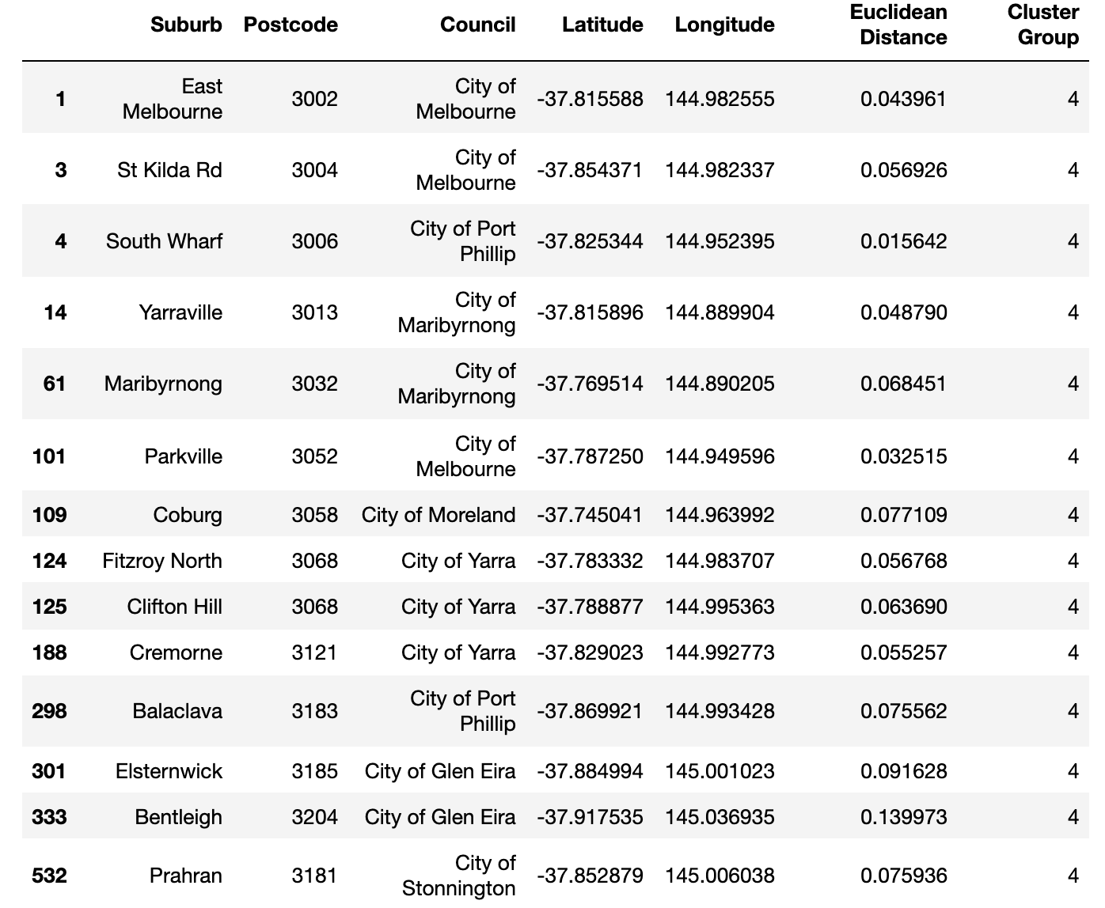
Conclusion
If the weights are evenly distributed across commute time, safety, rental status, and surrounding activities, it is recommended to search rental properties as the settlements for the coming overseas employees in the suburbs that obtained in Cluster 4.

Slide 38
Future Work
Inconsistent accuracy of datasets
Quality of datasets is inconsistent
Especially in rental dataset, missing data is filled with results calculated based on rental status of surrounding suburbs, the fabricated data could inevitably cause skewness in the dataset, leading the data analysis to conclude any unrealistic insight .
Solution:
Find alternative reliable and accurate datasets
Validate the accuracy of datasets during data collection
K-Means clustering only
Only conduct the K-Means clustering
Solution:
Find the best clustering method to ensure the best segmentations by exploring different clustering algorithms such as DBSCAN or hierarchy-based clustering (Agglomerative, BIRCH).

